Slide 1
Clean Code and Design Dilemmas
David Sackstein, CodePrecise
davids@codeprecise.com

Slide 2
Agenda
What is Clean Code?
The Clean Code Self-Contradiction
Why Don’t we Write Clean Code?
The Quick and Dirty Myth
Tests and the Legacy Code Dilemma
The Broken Window Theory

Slide 3
What is Clean Code?
Software that is easy to understand
  By other programmers
Software that is easy to maintain
  The effect of any fix is local and predictable
Software that is easy to extend
  Minimal changes to existing code

Slide 4
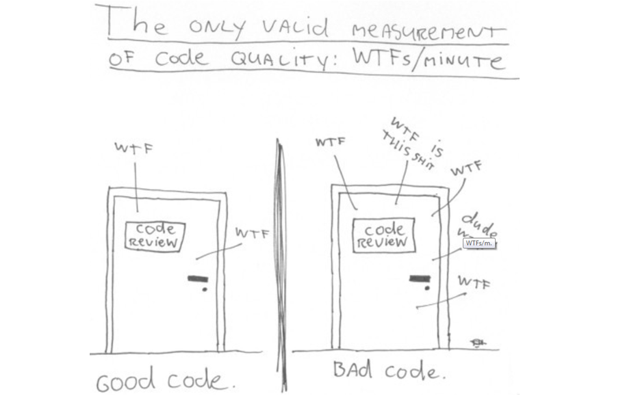
Code Quality Metrics
Notes:
Thom Holwerda
http://www.osnews.com/story/19266/WTFs_m

Slide 5
The Clean Code Self Contradiction
Code : “a system of words, letters, figures, or symbols used to represent others, especially for the purposes of secrecy” (Oxford Dictionary)
Clean Code: “Never obscures the designer’s intent “ (Grady Brooch, UML, OO Analysis and Design

Slide 6
Code or Clean?
“Code” is a historical term from the days in which code was intended to talk to computers and not to humans.
That approach is archaic.
“Any fool can write code that a computer can understand. Good programmers write code that humans can understand” (Martin Fowler)

Slide 7
Features of Clean Code
Meaningful abstractions
Small classes, small functions
Single Responsibility
One level of abstraction per function
Descriptive names
Few repetitions
Few arguments

Slide 8
Why Don’t We Write Clean Code?
We don’t think it helps
It takes time and we need to deliver fast
Its for purists. These principles cannot be implemented in real systems.
It would help if we started over, but today there is no point.
Lets discuss those …

Slide 9
Importance of Clean Code
Software changes years after we write it.
If it is difficult to maintain it will be patched.
The more it is patched the more difficult it is to maintain.
This vicious circle will slow us down until it brings development to a grinding halt.
Reversing Entropy requires input of energy!

Slide 10
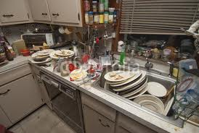
The Quick and Dirty Myth
Desert will be ready sooner if you leave the plates from the main course in the sink.

Slide 11
It’s Just Dirty
But the dirt will harden and be more difficult to clean.
The total cost of cleaning the plates will be higher if you postpone cleaning.
You will need to delay tomorrow’s dinner until you have cleaned the dirty plates.
And Slow

Slide 12
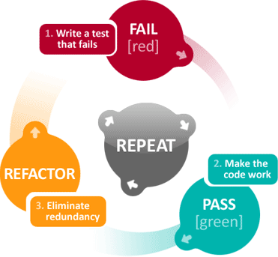
The Refactoring Process
Code however you like until it works
Then refactor
In T.D.D it’s a cycle:

Slide 13
Tests should be F.I.R.S.T
F | Fast (msec)
I | Isolated
R | Repeatable
S | Self-validating
T | Timely

Slide 14
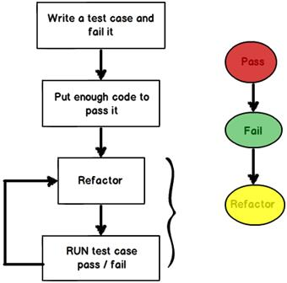
The T.D.D Cycle

Slide 15
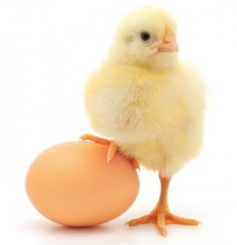
The Legacy Code Dilemma
What comes F.I.R.S.T? The tests or the code?
You need to fix legacy code that has no tests.
But tests cannot be written without refactoring.

Slide 16
Resolution - Iterate
Write a crude test and refactor a little
OR
Refactor just enough for a crude test.
Add more refined tests and refactor more.
See Michael Feather’s book:
Working Effectively with Legacy Code

Slide 17
Unit Tests vs. Integration Tests
Some define the difference by scope.
  Unit Tests test a single class
  Integration tests a number of classes
In practice, you should do both for exactly the same reasons.
Tests keep your code working all the time and allow you to refactor safely.

Slide 18
The Broken Window Theory
The theory states that maintaining and monitoring urban environments in a well-ordered condition may stop further vandalism and escalation into more serious crime.
Question :
How does this relate to Clean Code?
Notes:
James Q. Wilson and George L. Kelling

